Slide 1
Linear Model Selection and regularization
Chapter 06

Slide 2
Given a set of available features, how do we build the best set of features for our model?
Subset Selection
Best Subset Selection
Stepwise Selection
Choosing the Optimal Model
Shrinkage Methods
Ridge Regression
The Lasso

Slide 3
Improving on the Least Squares Regression Estimates for models with many features
Given a set of observations, in Linear Regression, the cost can be expressed as MSE or RSS or R²
Either least-squares fitting process or an iterative optimization picks coefficients that minimize this cost
There are 2 reasons that coefficients selected using these cost estimates may not be ideal:
Prediction Accuracy on non-training data
Model Interpretability for features

Slide 4
Prediction Accuracy Problems
The Linear Regression estimate has low variability especially when the relationship between Y and X is linear and the number of observations n is much larger than the number of predictors p
But, when , then the fit can have high variance and may result in overfitting and poor estimates on unseen observations – poor generalizability
And, when , then the variability of fit increases dramatically, and the variance of these estimates are unacceptable

Slide 5
Model Interpretability Problems
When we have a large number of features in the model there will be many that have little or no influence on Y
But the coefficients for most features will be non-zero
Leaving these variables in the model makes it harder to determine “important variables”
The model would be easier to interpret by removing the unimportant variables and fitting the model to only the important variables

Slide 6
Solution Concepts
Subset Selection
Identify a subset of all p predictors which best predict the response Y, and then fit the model using only this subset
Methods: best subset selection and stepwise selection
Regularization through coefficient Shrinkage
Penalize the model (new cost function element) for having non-zero estimates of coefficients -> pushes coefficients towards zero
This shrinkage reduces the variance WHY?
Some of the coefficients may shrink to exactly zero – helps with variable selection/interpretation
Methods: Ridge regression and the LASSO
Dimension Reduction
Project all p predictors into an M-dimensional space where M < p, and then fit a linear regression model
Example: Principle Components Regression

Slide 7
6.1 Subset selection
Use a wrapper method to evaluate and select the best performing set of features
Best Subset Selection
Forward Subset Selection
Backwards Subset Selection

Slide 8
6.6.1 Best Subset Selection
Fit a linear regression model for each possible combination of the X predictors
How do we judge which subset is the “best”?
Choose the feature subset using training data performance
Choose the feature subset using validation data performance
What are the pro’s and con’s of each option?

Slide 9
Choose the feature subset with training performance
One computationally simple approach is to take the subset with the lowest training error
Could we use smallest RSS or the largest R² on the training data?
Unfortunately, the model that includes all the variables will always have the largest R² (and smallest RSS) and will appear to be the best model given the training data

Slide 10
RSS and R² vs. Feature Subset Size
RSS will never increase (and R² will never decrease) as the number of variables increase - not very useful
Grey dots – actual performance of various subset models on Credit default data
red line: the best model for a given number of predictors, according to RSS and R²

Slide 11
Measures for Estimating model Performance on unseen data from training data fit
To compare different models, adjust the RSS of the training data model fit based on some penalty for number of features (p211-212):
Adjusted R²
AIC (Akaike information criterion)
BIC (Bayesian information criterion)
C_{p} (Mallow’s C_{p}: Proportional to AIC)
These methods attempt to compensate by adding penalty to RSS for the number of variables (i.e. flexibility) in the model

Slide 12
Behavior of: C_{p}, BIC, and Adjusted R²
A small value of C_{p} or BIC indicates a low error, and thus (hopefully) a better model
A large value for the Adjusted R² indicates a better model

Slide 13
Feature Selection through Best Subset Selection using validation results
Using model’s fit on training data is not as good as using non-training data for decision-making
Best Subset Selection considers all possible subsets of available features to find the optimal fit using validation data
Select the model using the subset of features which yields the best performance on the (cross) validation data
e.g. best MSE or lowest classification error

Slide 14
Feature Selection via Stepwise Selection
Best Subset Selection is computationally intensive especially when we have a large number of predictors (large p)
More computationally-attractive methods:
Forward Stepwise Selection: Begins with the model containing no predictor, and then adds one predictor at a time that improves the model the most until no further improvement occurs
Backward Stepwise Selection: Begins with the model containing all predictors, and then deleting one predictor at a time where the predictor chosen at each step is the feature that causes the least degradation to model performance when removed.

Slide 15
REGULARIZATION Methods (Parameter Shrinkage)
Use the loss function to shrink parameters for less-important features
Ridge Regression
The LASSO

Slide 16
6.2.1 Ridge Regression
Ordinary Least Squares (OLS) estimates β’s by minimizing
Ridge Regression uses a slightly different minimization equation which adds a term…

Slide 17
Ridge Regression Adds a Penalty on β
The effect of this equation is to add a penalty of the form
Where the tuning parameter λ is a positive value.
This has the effect of “shrinking” large values of β’s towards zero.
This penalty should improve the fit because shrinking the coefficients can significantly reduce their variance
When λ = 0, we get the original RSS optimization equation from Ordinary Least Squares:

Slide 18
Ridge Regression on credit data
As λ increases, the standardized coefficients shrinks towards zero.
Will coefficients ever reach zero?
If not, what are the implications with model interpretability?

Slide 19
Why can shrinking coefficients towards zero be a good thing to do?
When n and p are of similar size or when n < p, then the OLS parameter estimates will be extremely variable.
The penalty term makes the ridge regression estimates more biased and can substantially reduce variance
Ridge Regression implements a λ-tunable bias / variance trade-off control for parametric models

Slide 20
Ridge Regression Bias / Variance
Black: MSE due to Bias
Green: MSE due to Variance
Purple: MSE ~ Bias+Variance
Increase in increases bias and decreases variance

Slide 21
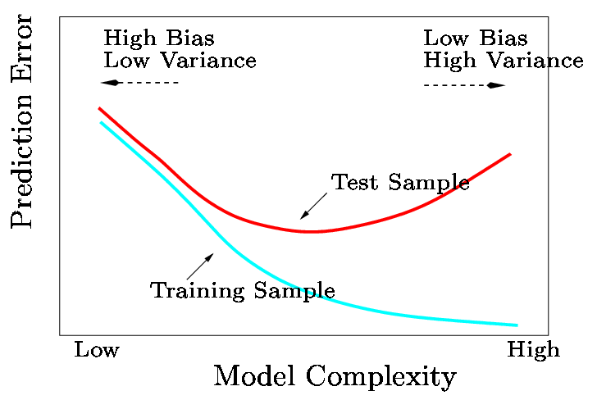
Bias / Variance Trade-off
In general, the ridge regression estimates will be more biased than basic OLS … but have lower variance
Ridge regression will work best in situations where the basic OLS estimates have high variance

Slide 22
Computational Advantages of Ridge Regression
If p is large, then using the best subset selection approach requires exhaustive computation of all possible subsets of features
With Ridge Regression, for any given λ, we only need to fit one model
Ridge Regression can even be used when p > n, a situation where OLS fails completely

Slide 23
6.2.2. The LASSO
Ridge Regression isn’t perfect - the penalty term will never force any of the coefficients to be exactly zero. Thus, the final model will include all variables, which makes it harder to interpret
An alternative is the LASSO: Least Absolute Shrinkage and Selection Operator
The LASSO works in a similar way to Ridge Regression, except it uses a different penalty term

Slide 24
Ridge Regression vs. LASSO: Penalty Term
Ridge Regression minimizes
The LASSO estimates the by minimizing

Slide 25
Credit Data: LASSO
Parameter values are driven to zero

Slide 26
6.2.3 Selecting the Tuning Parameter λ to find the best performing model
We need to decide on a value for λ
Select a grid of potential values, use cross validation to determine error rate (for each value of λ) and select the lambda value that gives the lowest error rate

Slide 27
Benefits of LASSO
Using this penalty, it could be proven mathematically that some coefficients end up being set to exactly zero
With LASSO, we can produce a model that has high predictive power and it is simple to interpret because some coefficients are driven to zero

